Slide 1
Why tax? A 10-minute semi-academic explanation Riga 13 October 2017
Morten Hansen
Head of Economics Department, SSE Riga Member of the Fiscal Discipline Council of Latvia
morten.hansen@sseriga.edu

Slide 3
Reasons for taxation
Where the market economy ‘fails’…..
Provision of public goods
Correcting ‘wrong’ equilibria
Income redistribution
Addressing inequality issues

Slide 4
Other concerns
Income taxes that maximize labour supply
Taxes that limit the size of the grey economy
Corporate taxes that stimulate investment and growth

Slide 5
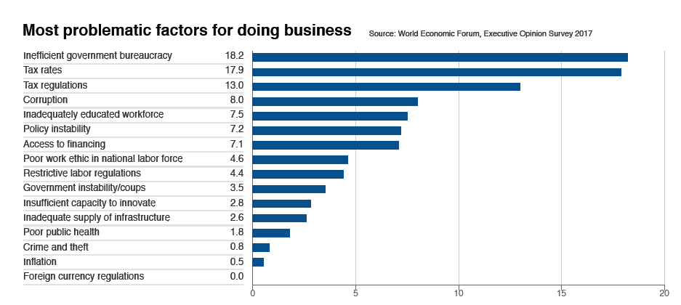
Survey, Latvia, World Economic Forum’s Global Competitiveness Report 2017-18

Slide 6
Gini coefficient, EU28, 2015
The Baltic economies are quite unequal – by EU standards

Slide 7
GDP per capita (USD) against tax revenue EU28 (minus Lux and Ireland)
Latvia
Estonia
Lithuania

Slide 8
GDP per capita (USD) against tax revenue EU28 (minus Lux and Ireland), adding USA

Slide 9
Brief conclusions
No ‘ideal’ level of inequality
No ‘ideal’ size of taxes to GDP
Some Latvian taxes are counterproductive (social taxes)
But the size of taxes etc. – a question of politics/values/beliefs

Slide 10
Thank you for your attention! Questions and comments are welcome
Stockholm School of
Economics in Riga
Founded 1994

