Slide 1
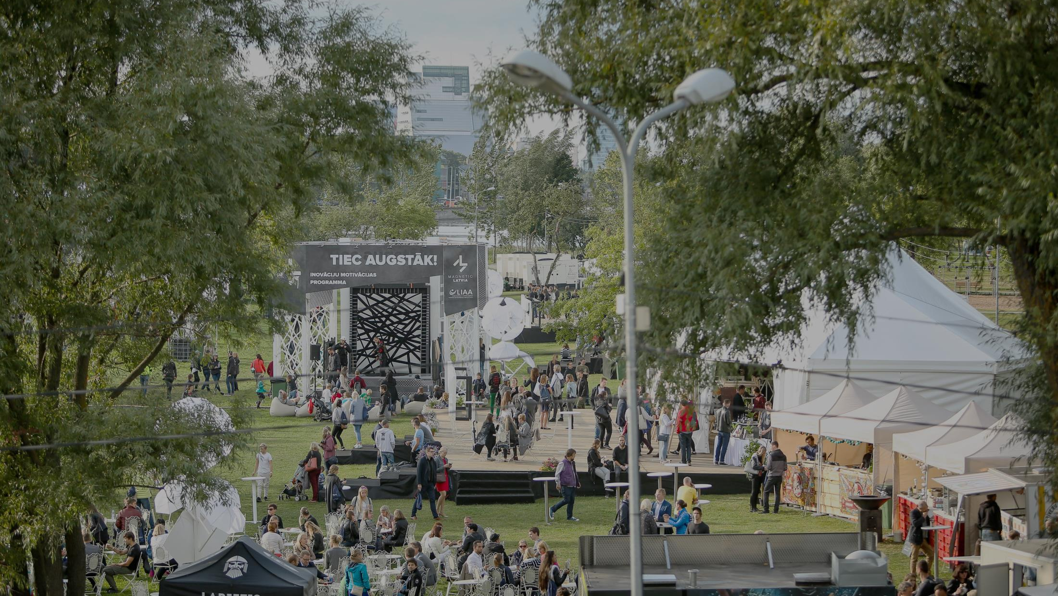
Inovuss video

Slide 2
Investment and Development Agency of Latvia
Tourism Promotion

Slide 3
Norway and Sweden
Priority markets
Number of visitors and nights spent in hotels and other accommodation establishments
Notes:
Important:
Sweden and Norway are priority tourism markets
LIAA representative offices in Sweden and Norway- more power for attracting tourists from Sweden and Norway
Changes in tourism flow:The increase in Swedish tourism has been facilitated by several factors:
From the end of 2016, from Riga to Stockholm, there are 2 ferries serving between Riga and Stockholm.
LIAA and Tallink marketing activities, also contributing to the arrival of the Swedes with one vessel, remain overnight and leave the other. Additionally to flights to Stockholm, airBaltic has launched a flight from Riga to Gothenburg (full flights)
SAS flights from Stockholm to Riga
LIAA Marketing activities done, according to tourist segments that need to be addressed in Sweden.
Unstability and Security situation in other European countries ( terror attacks etc.) stimulates growing popularity of closer tourism destinations.
Changes in tourism flow in Norway : The decrease in Norwegian tourism has been facilitated by several factors:
The Norwegian economy has been volatile in recent years, adversely affecting the tourism sector. This has resulted in fewer advance bookings and difficult to predict future trends
According to airBaltic, tourist flow has been influenced also by the fact that airBaltic has no longer a SAS codeshare agreement (which previously allowed groups with tickets from all over Norway).
Well and our price level in Riga is not very competitive anymore.
New flights from Oslo had opened to several equally attractive tourist destinations (tourism offer & price level).

Slide 4
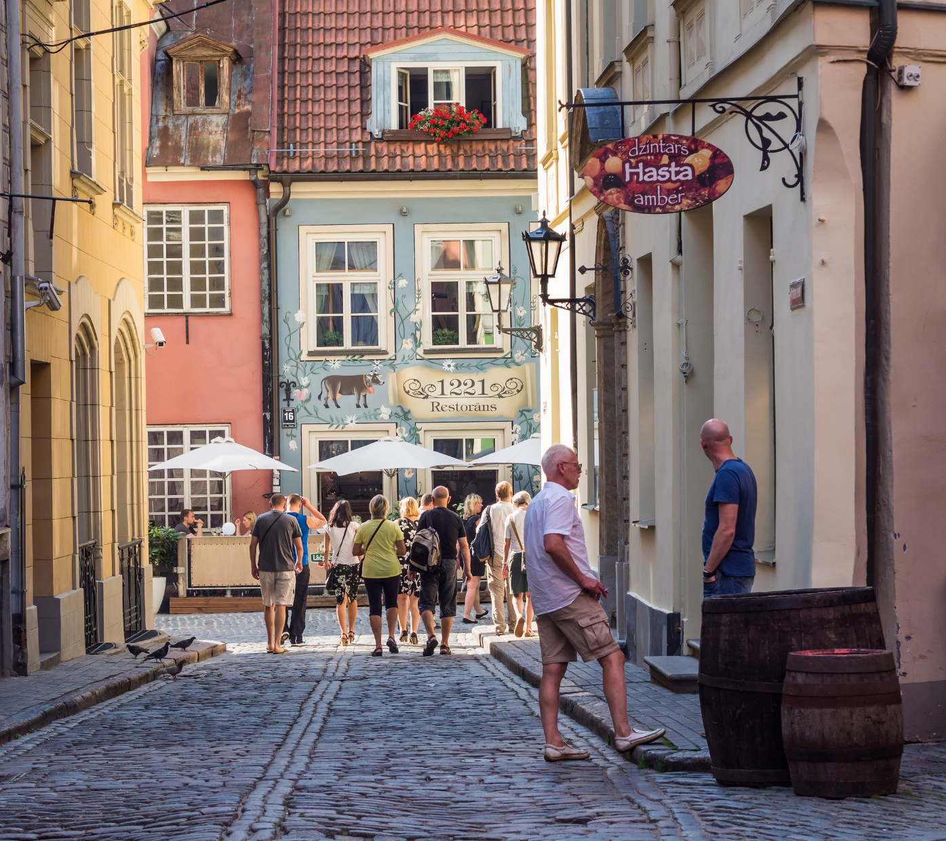
Target groups
Notes:
Tourism trends affecting the selection of tourism target audiences.
WHOPs (Whealthy, Healthy Older People), or "Active Seniors"
Double Income, No Kids (DINKs)
Millennials and Generation Z (digital natives)
MICE segment
Common tendences:
The ever more «hectic lifestyle», stress, lack of time, and other contemporary trends, especially in the business sector, place more emphasis on the importance of free time.
Free time is expected both for physical and mental recovery in a short period of time.
Demographic change, the "aging" of the population and the global catastrophes, is the future of the so-called megatrend, which changes the consumer segment and interests and direction.
Greater trust is already known destinations, products and services.
Tourists looking for safer destinations.
Exclusive and authentic tourism experiences. (searching for unique, exclusive experiences that create lasting memories. Part of this trend is an interest in authentic experiences in non-traditional destinations where travellers can interact with local people.)
Increasing interest in specialised holidays offers opportunities
The importance of wellness and health tourism is increasing.
Peer-to-peer travel is expanding. (consumers offer travel products to other consumers through online platforms. This allows inhabitants of tourist destinations to sell tourism products to travellers without involving professional tourism suppliers. Overnight stays at people’s homes, followed by dining experiences. For example, Airbnb.)
Travelers are looking for new destinations, quality services at an adequate price. (The determining factors are not only price, service and quality, but also an emotional factor.) Tourists are looking for an experience, but with a particular purpose and meaning.
Professional online presence is becoming a necessity
(For attracting more tourists- Online presence is becoming increasingly important. Social media, review sites and blogs are key channels to communicate with your potential customers. Visual storytelling is an especially effective way to reach them.
Social media and review sites are key in travel planning. (Social media have become main sources of travel information before, during and after a trip. )

Slide 5
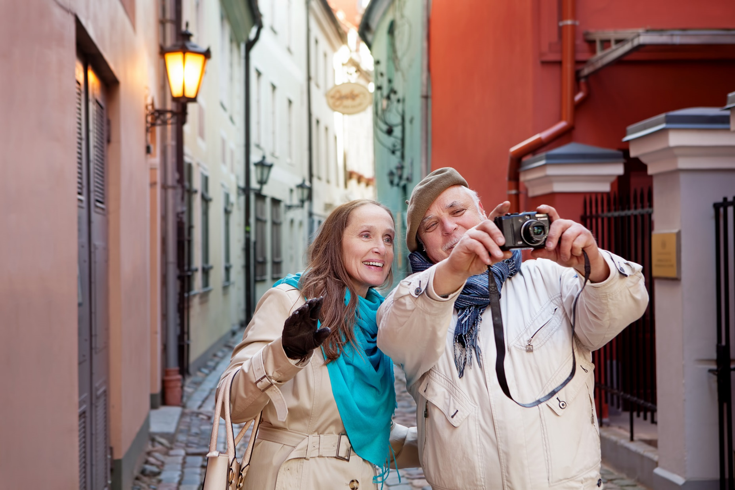
Target groups
Wealthy, Healthy Older People (WHOPs)
increasing group of travellers
vital, healthy, time and money
Notes:
WHOPs (Whealthy, Healthy Older People), or "Active Seniors" are becoming one of the most important segments of tourists. They are the first generation charter travellers, and they view travel as a natural part of their lifestyle.
New generation seniors are healthier, more active, energetic and wealthier, and experienced travelers.
In the coming years, many of the post-war baby boomers will retire. They have time and money, which they gladly spend on travel, entertainment, experiences and everyday luxury. Make both long and short trips and enjoy the benefits of free time. Interested in culture and natural experiences. Being curious, they are keen to experience and learn.

Slide 6
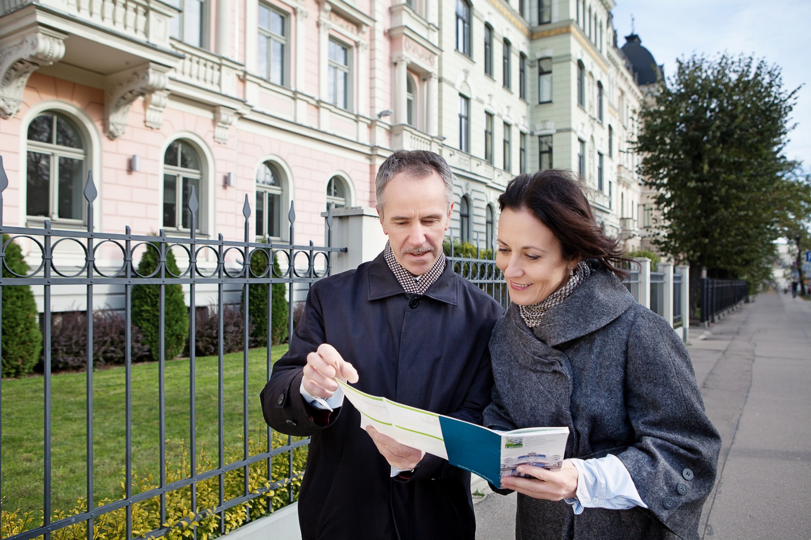
Middle Aged
still employed
intensive trips with active culture programs
knows what they like and want, but also open to new things and ideas
Notes:
“Middle-aged” have their children already on their own, coming together without influencing the way of traveling, or staying at home while their parents travel. “Middle-aged” have lived up to their professional ambitions, but are still employed. “Middle-aged” cannot travel for long trips, but make their limited vacations intensive with active culture programs. “Middle-aged” are comfort seekers and their income allows them able to pay for this.
Most of the middle aged group knows what they like and knows what they want, but are also open to new things and ideas.

Slide 7
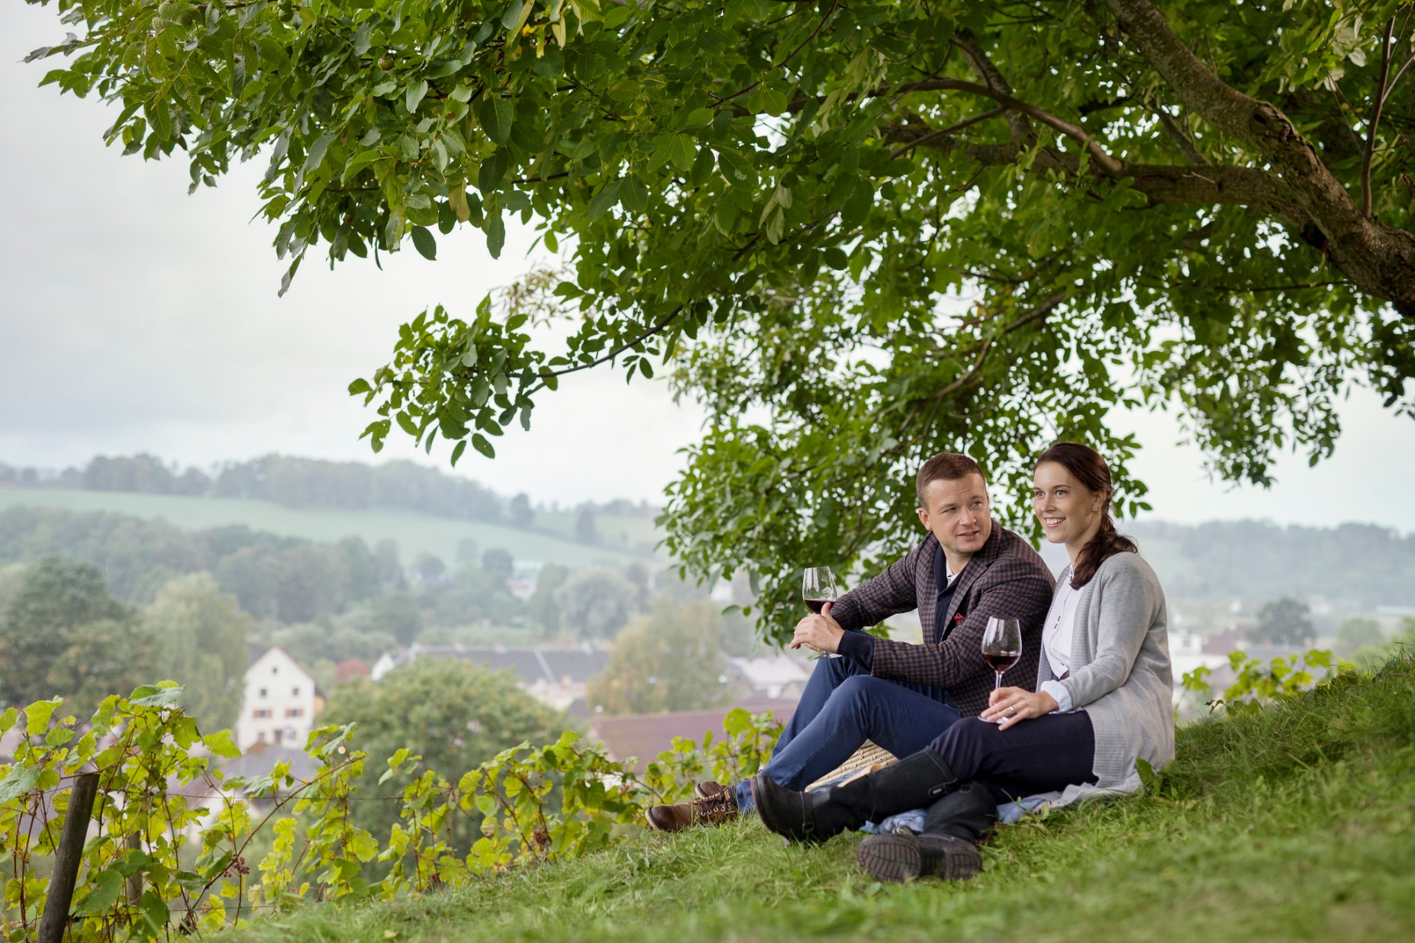
Target groups
Double Income, No Kids (DINKs)
travel is part of the lifestyle
today’s or tomorrow’s decision-makers
Notes:
For this segment, travel is part of the lifestyle. They grew up with parents who travelled, and they travel a lot themselves, both privately and for work.
Being experienced travellers, they have high demands in terms of travel services and produces, and that the destination delivers on its promises.
They are time-poor, so they value their free time highly.
DINKs are often today’s or tomorrow’s decision-makers, and are already perceived by friends as leaders and opinion-makers.

Slide 8
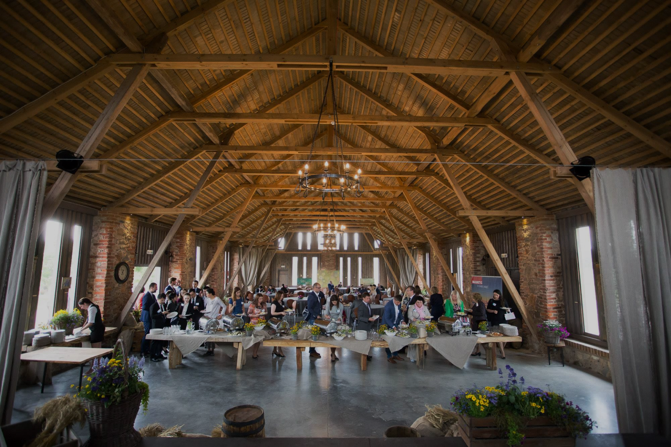
MICE
- business meetings and incentives
Notes:
Affordability, accessibility, reliability and safety make Latvia an appealing destination for hosting MICE events.
Our purpose- is to influence decision-makers at companies that could potentially hold meetings in Latvia
Image-building activities in Latvia and by communication about attractive Latvian experiences to the private part of the Global Traveller target group.
Today the target group demands high levels of accessibility and security.
The market for business and incentive travel has changed in recent years.
Cost and time effectiveness have gained importance among the target group.
This has resulted in shorter meetings as well as tougher competition.
They want functioning, creative arrangements and a wide range of exciting peripheral activities.
Important success factors include price, quality, accessibility, infrastructure, new and image-building destinations and creative programmes.

Slide 9
Marketing campaigns
1.
Notes:
Very targeted to main segments.

Slide 10
2.
Digital media
Inspiration
Information
Awareness
Notes:
We are already involving blogers and social media influencers in our digital strategy and we will continue to develop this succesful cooperation further with both local and international talents.
Secondly we are planning test how can we integrate international bloger trips in our overall digital content strategy.

Slide 11
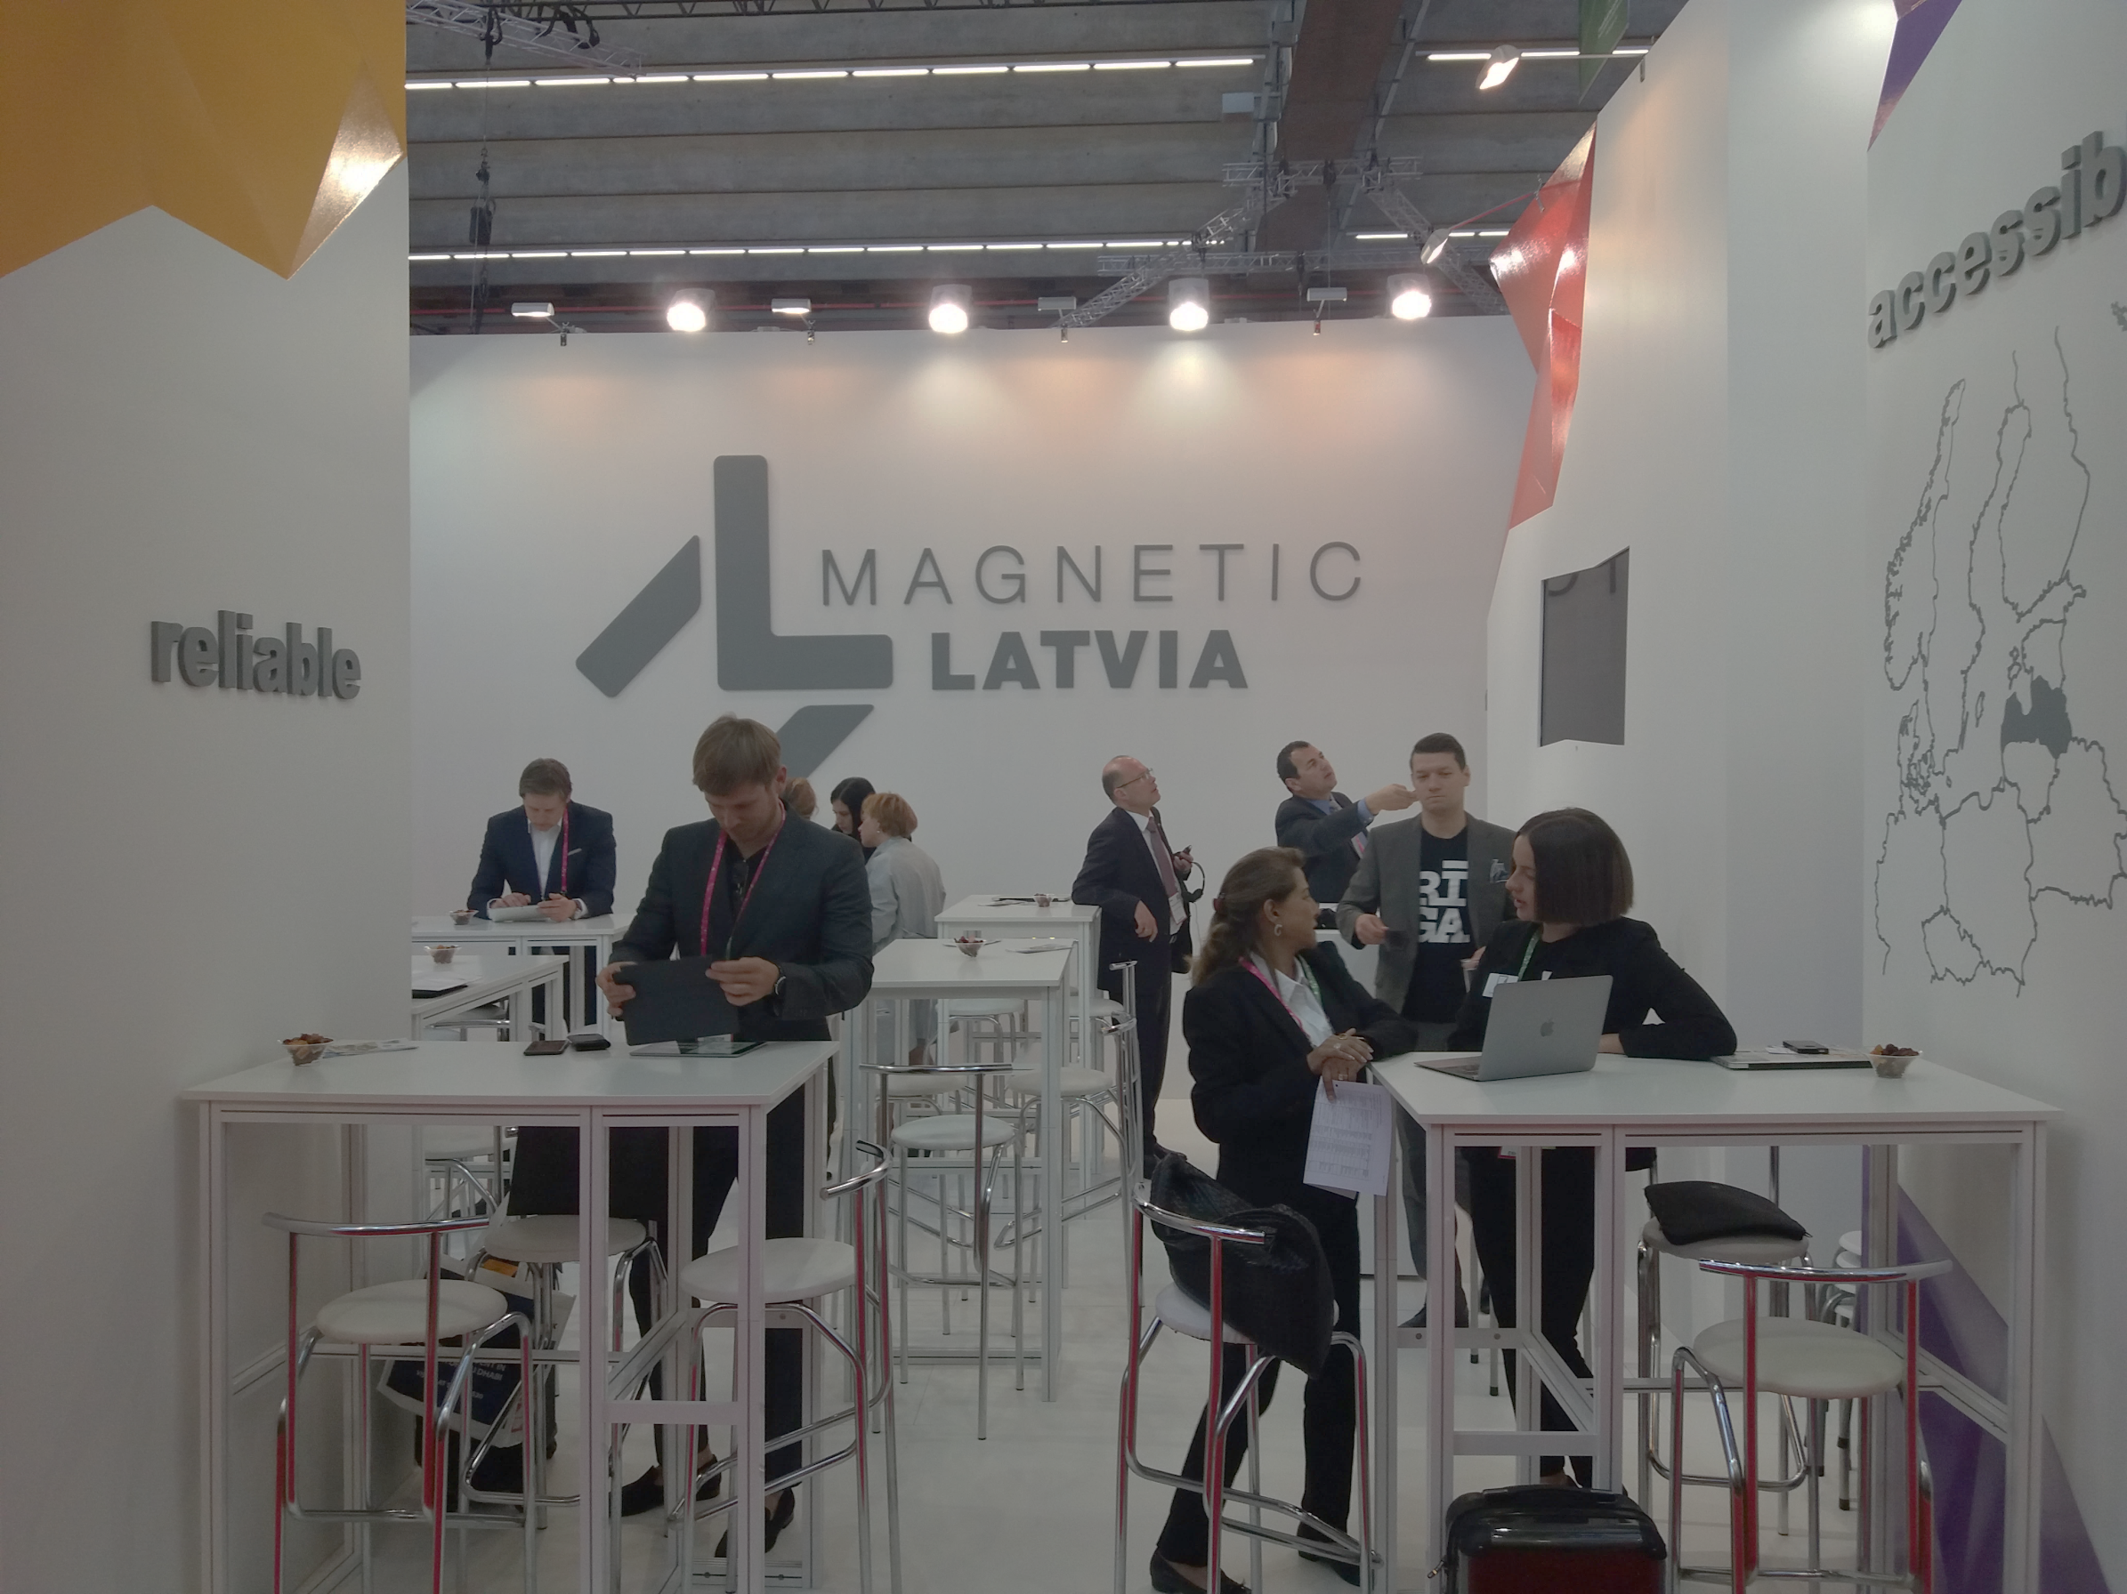
Specialized Trade Exhibitions
3.
Notes:
Specialized B2C events for senior auditorium.
Thematic tourism exhibition "Senior"
Participation in the thematic exhibition "Senior" to be held in Stockholm, Sweden, Stockholm in October.
Exibition is divided into several thematic lines: travel and tourism, accommodation and services, health and beauty, and other topics suitable for the senior auditorium.
The Swedish "silver generation" is an active and wealthy traveler and is spending considerable money on this.
Participation in the exhibition is organized with the aim of attracting Swedish travelers of the ages, promoting high value-added tourism products - culture, historical heritage, recreation and health improvement opportunities, among them emphasize the common historical links, geographical proximity and convenient transportation possibilities to Latvia.
Next event will be in October, 2018.

Slide 12
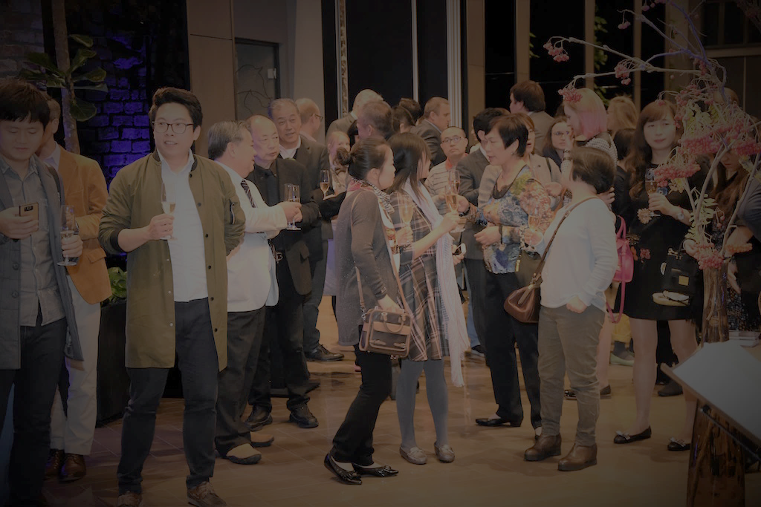
1.
Digitālā vide un mediji
Iedvesmot
Informēt
4.
Workshops, B2B events
Notes:
Zviedrijā un Norvēģijā iztrūkts lielo tūrisma izstāžu ( TUR Gēteborgā kļuva vāja, tāpat Reseliv Norvēģijā). Tādēļ mārketinga aktivitātes tiek veikts ņemot par pamatu potenciālās auditorijas .
Cooperation with ANTOR ( Association of national Tourism Orgaization in Sweden and Norway)
Media B2B ( traditional media breakfast)
B2B Events for tourism professionals.
SWEDEN:
B2B event for MICE professionals «Meet &Travel»( 2018.spring TBC)
200 MICE buyer «hand picked» from Swedish corporate companies.
Travel News Market
Tourism Professionals Forum and B2B networking, platform for meeting tourism professionals in Sweden and other destinations.
The event will be attended by more than 160 participants from different fields of tourism (destinations, airlines, accommodation, ferry companies, etc.), as well as more than 1000 event visitors, tourism professionals from Sweden (tour operators, travel agents, industry professional associations, media, etc
5 -6 SEPTEMBER, 2018. Stockholm & Helsinki B2B Travel Show is a workshop where you find clients and networks both in Stockholm and Helsinki, on board m/s Silja Serenade in harbour. Totally 600 professionals on board. Travel agents, tour operators, travel managers, buyers and VIP´s from companies, network contacts as well as media and bloggers .
SWEDEN &NORWAY
Thematic seminars in cooperation with the National carrier airBaltic and the Latvian tourism industry (Latvia 100)

Slide 13
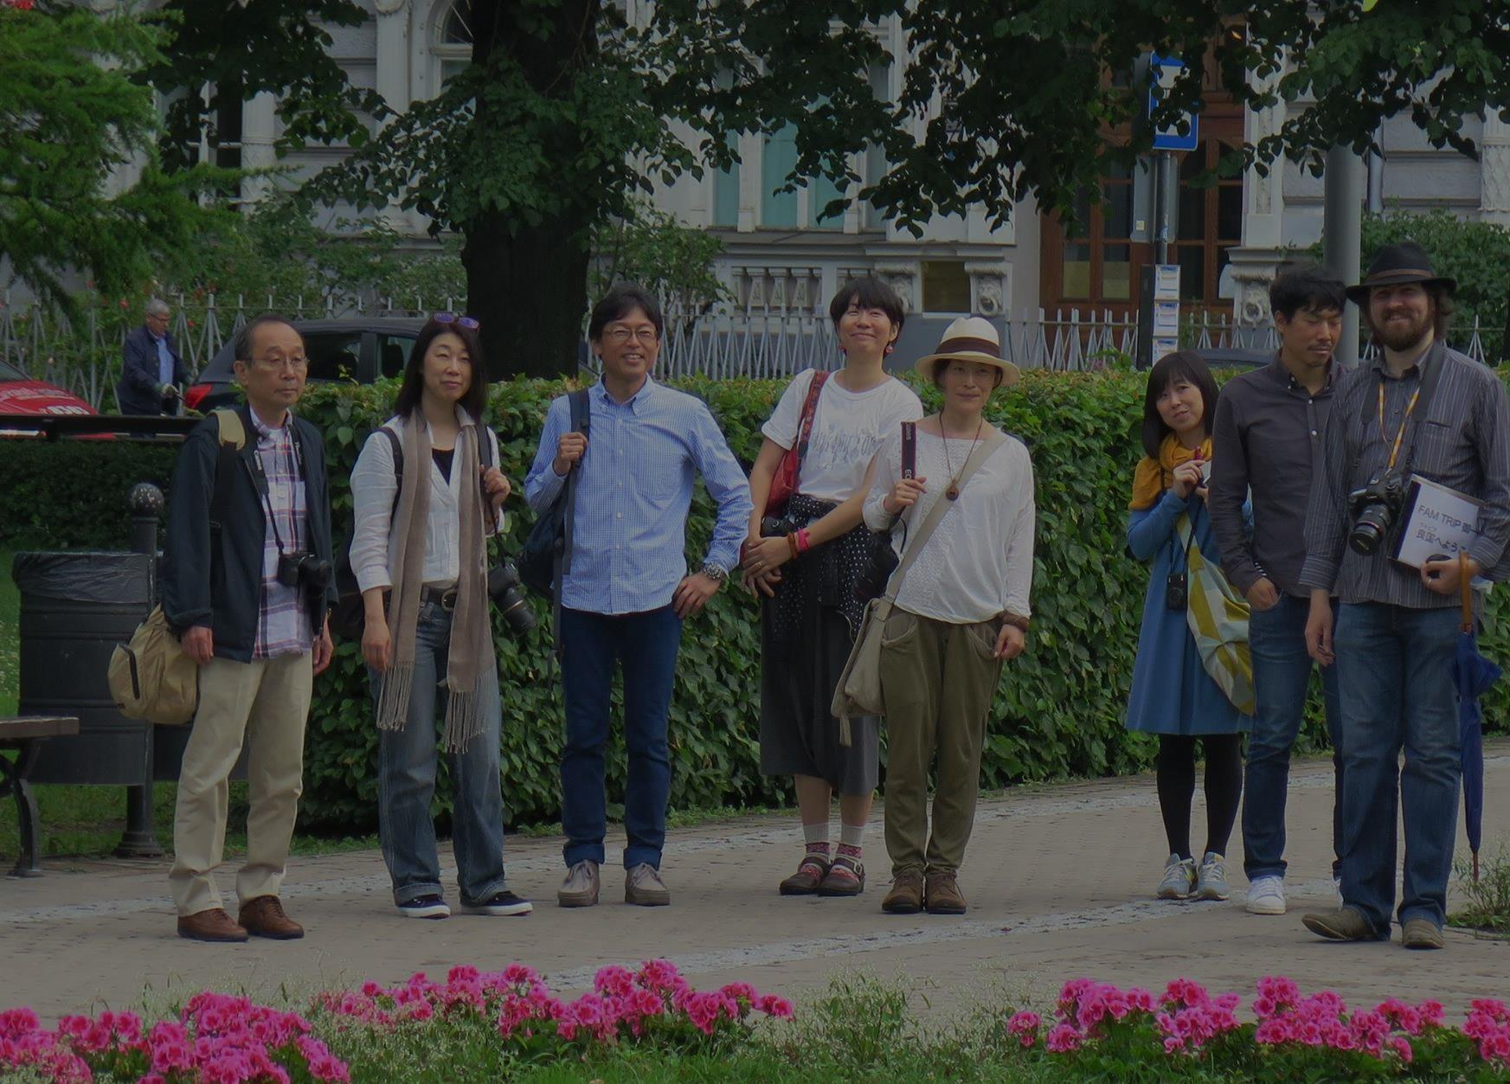
5.
Media trips and fam trips for TO

Slide 14
Switzerland
Number of visitors and nights spent in hotels
and other accommodation establishments
New route: Riga – Geneva (Opened in May, 2017)
Cooperation with AirBaltic
Latvian Tourism seminars
Media and TO visits
Publications
+16%
+20%

Slide 15
Ireland
Number of visitors and nights spent in hotels
and other accommodation establishments
Main target group - Diaspora tourists
Travel motivation - Visit friends and relatives
Have positive impact on regional tourism
Have close ties with Latvia

Slide 16
Domestic tourism
Campaign 2018

Slide 19
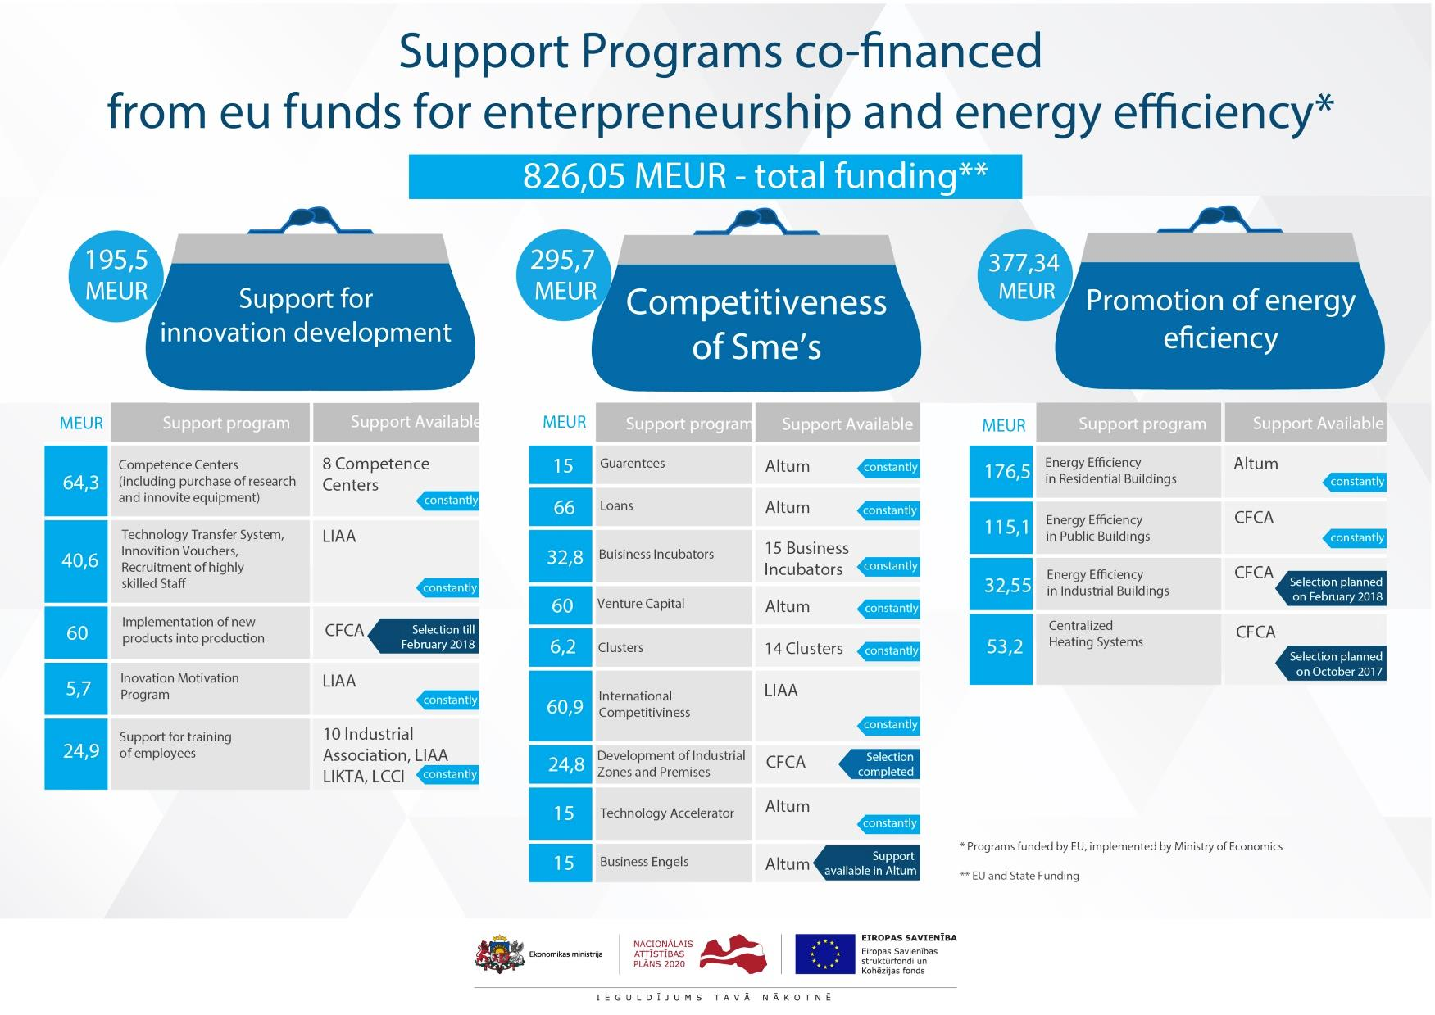

Slide 20
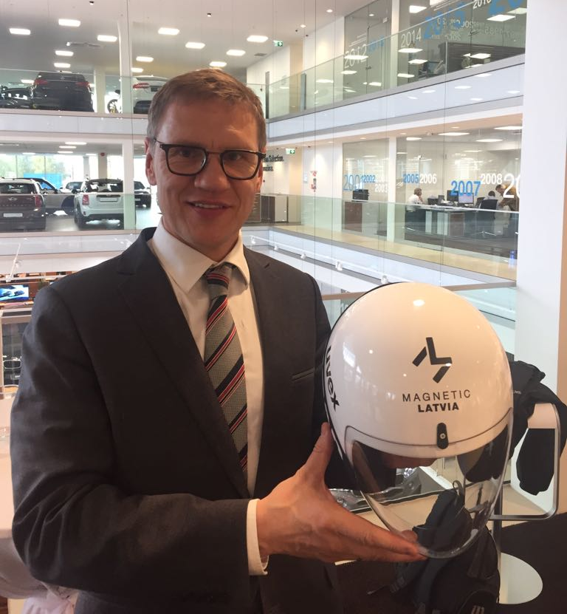

Slide 24
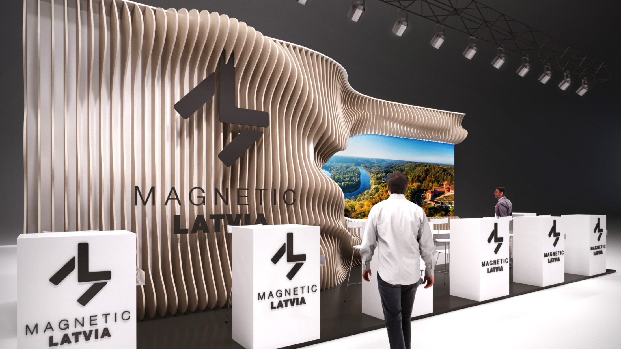

Slide 25
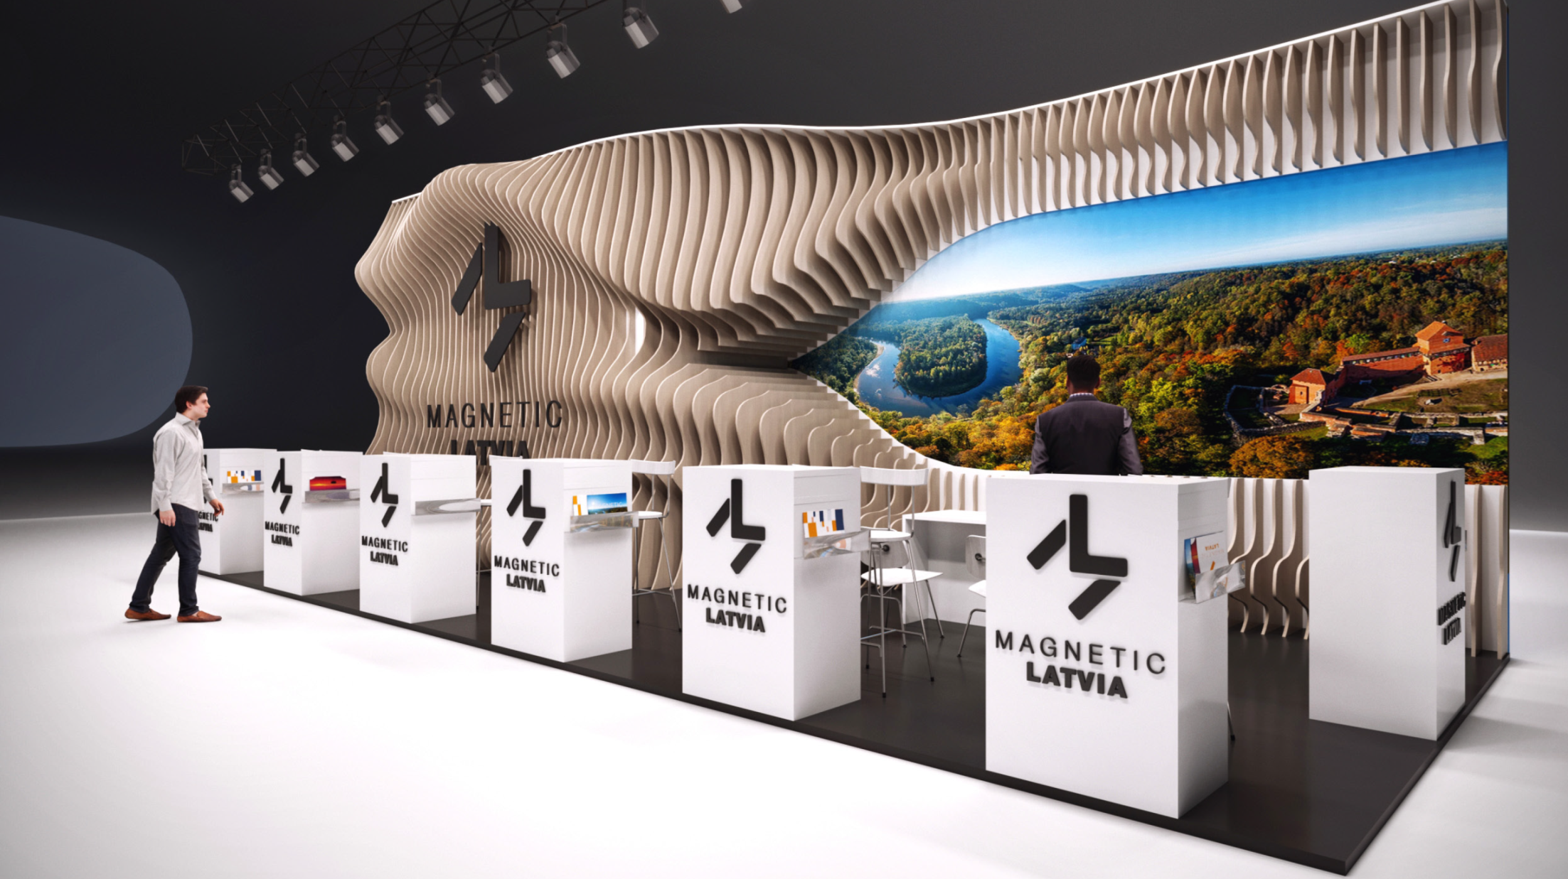

Slide 26
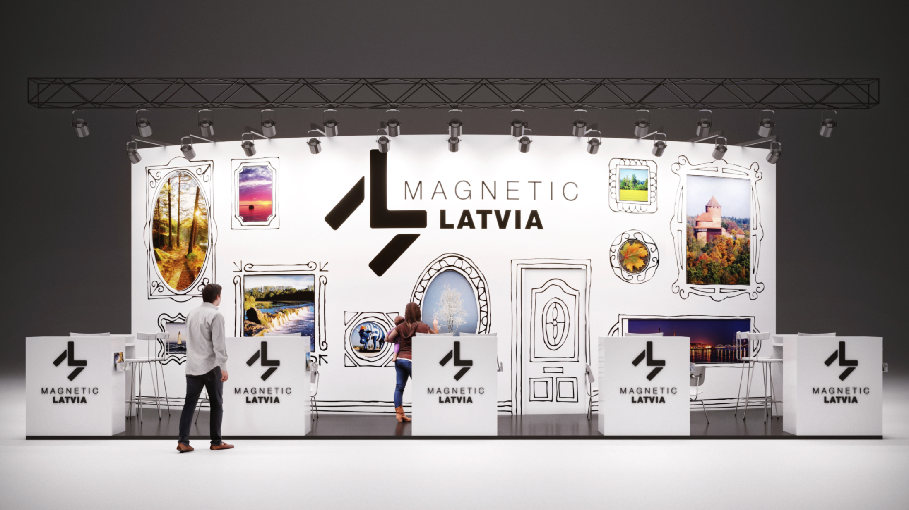

Slide 27
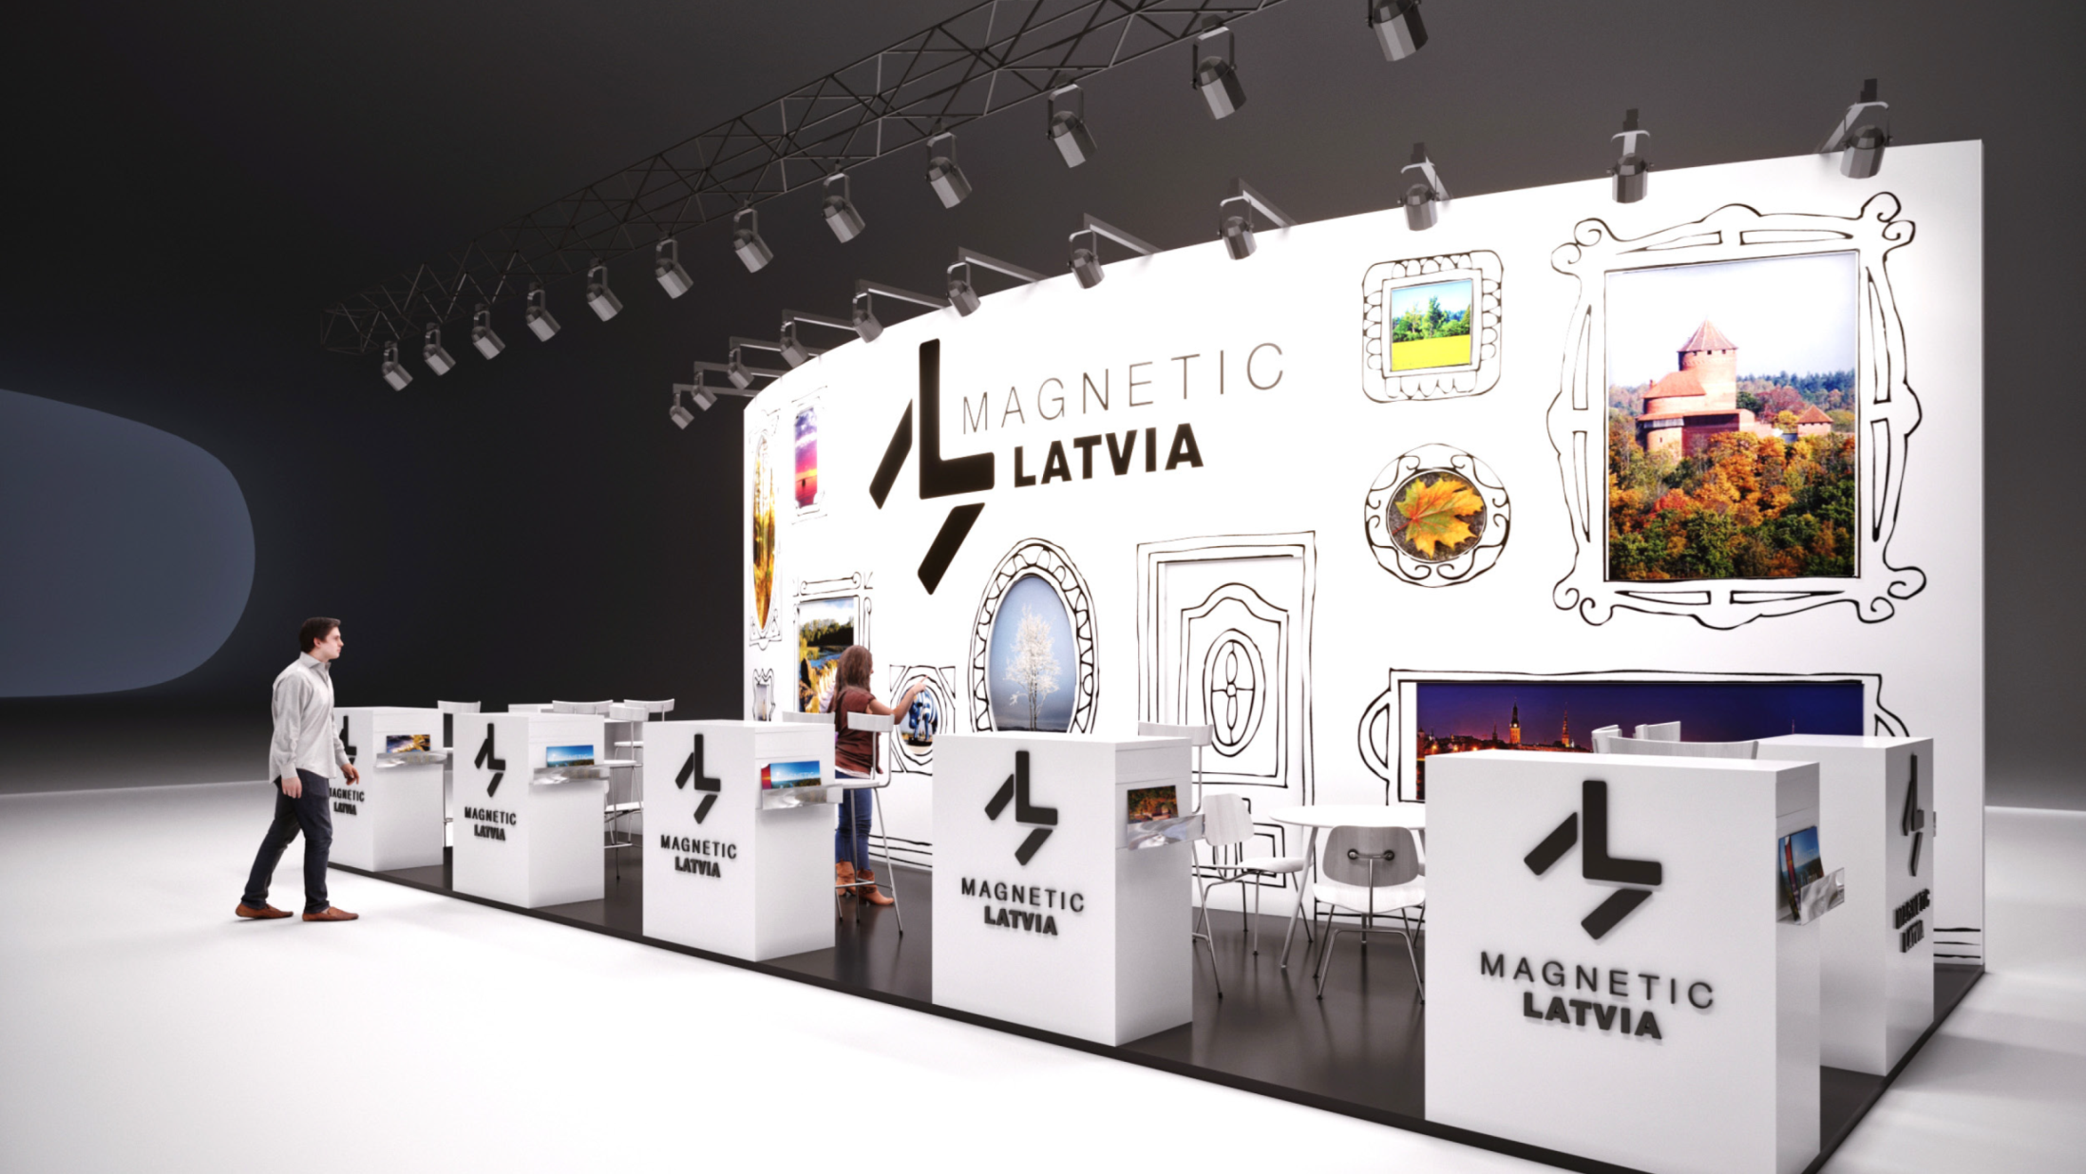

Slide 29
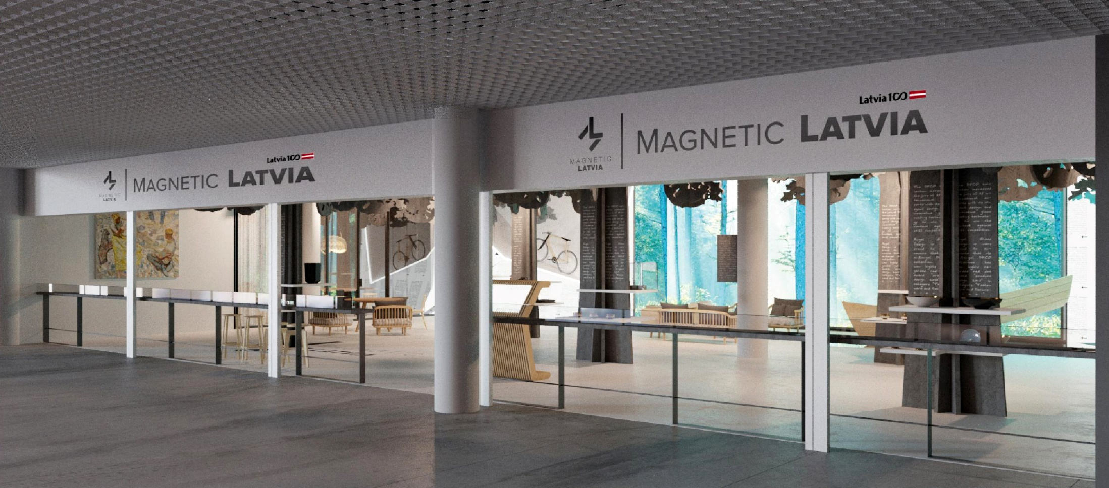

Slide 30
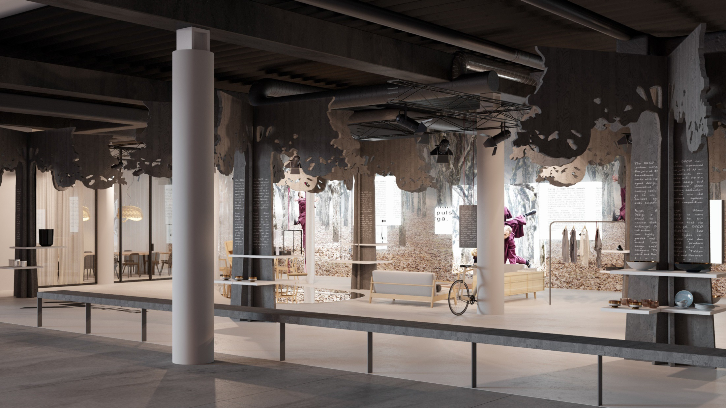

Slide 31
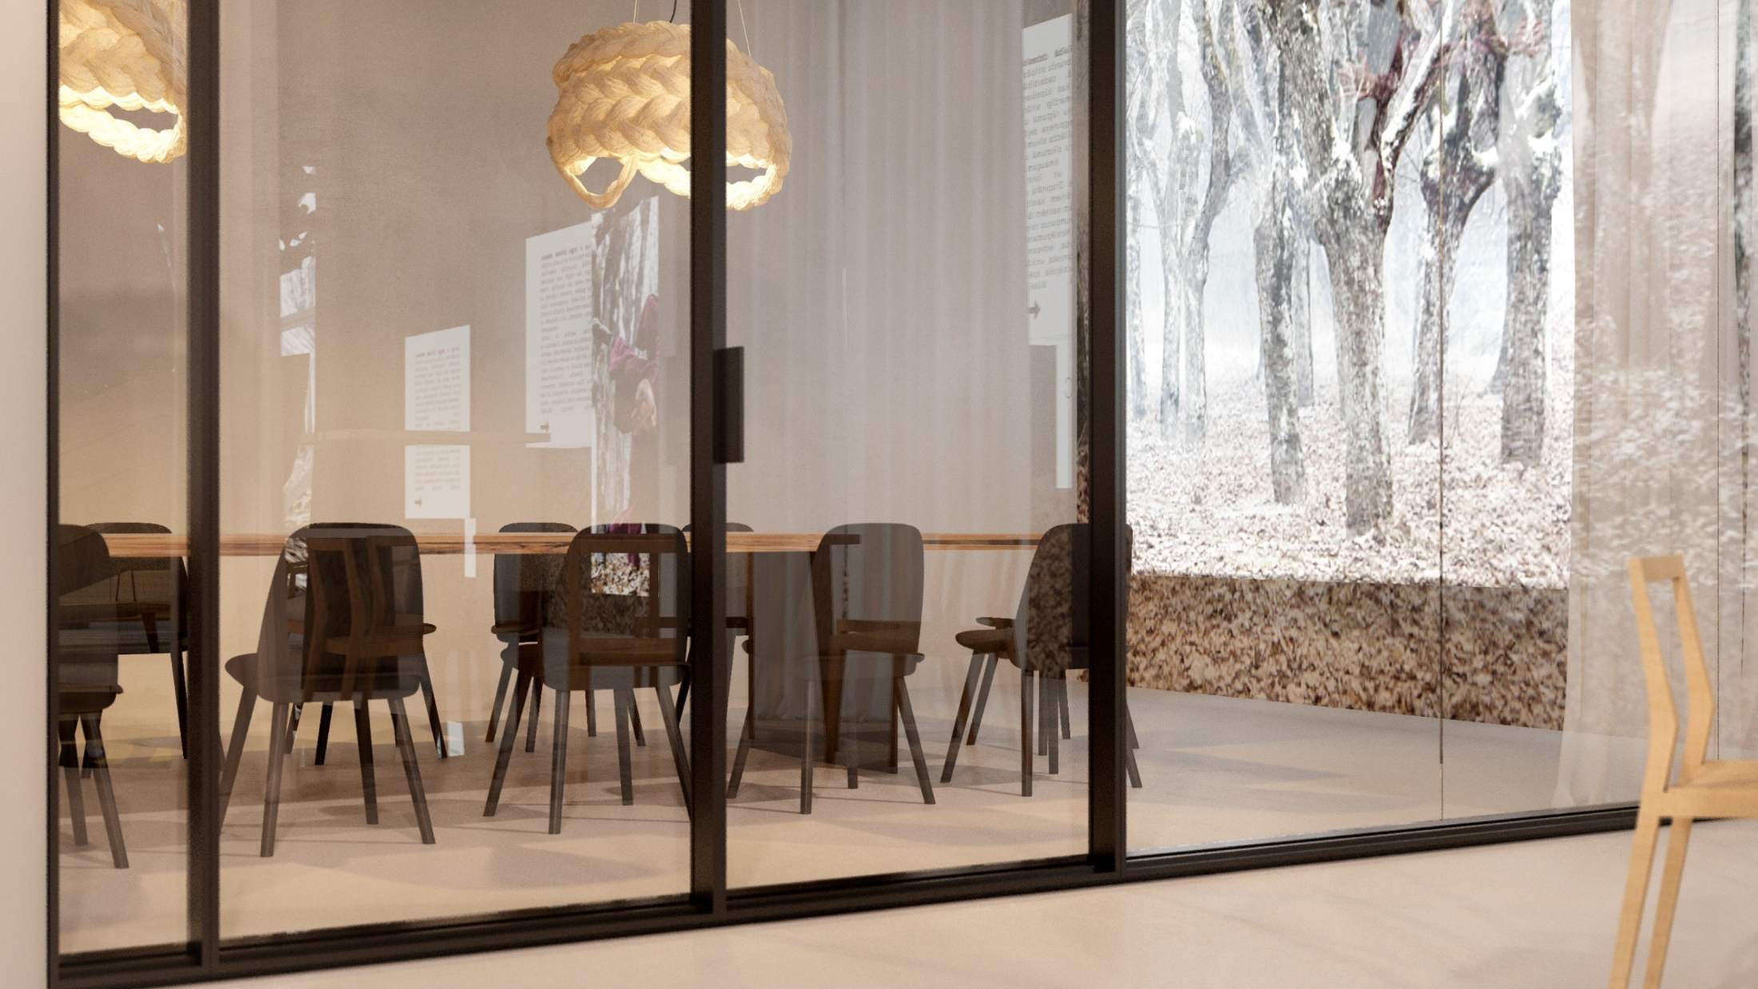

Slide 33
